Slide 1
NLP Course
Lecture 1. Distributional Hypothesis
February, 2021

Slide 2
Plan for the lecture
Representations and One-hot vectors (5 min)
Meaning and Distributional hypothesis (5 min)
Classical Approach and Neural Approach (10 min)
Word2Vec, Naïve and Negative Sampling (15 min)
Glove (5 min)
Implementation of Naïve Word2Vec (15 min)
Demo the word analogies (5 min)

Slide 3
Why do we even care about representation?
I train a model.
Text (the input)

Slide 4
Why do we even care about representation?
I train a model .
Sequence of tokens
I train a model.
Text (the input)

Slide 5
Why do we even care about representation?
Word representation – vector, it becomes an input for algorithm
I train a model .
Sequence of tokens
I train a model.
Text (the input)

Slide 6
Why do we even care about representation?
Your favourite ML model
Any algorithm for a task
Word representation – vector, it becomes an input for algorithm
I train a model .
Sequence of tokens
I train a model.
Text (the input)

Slide 7
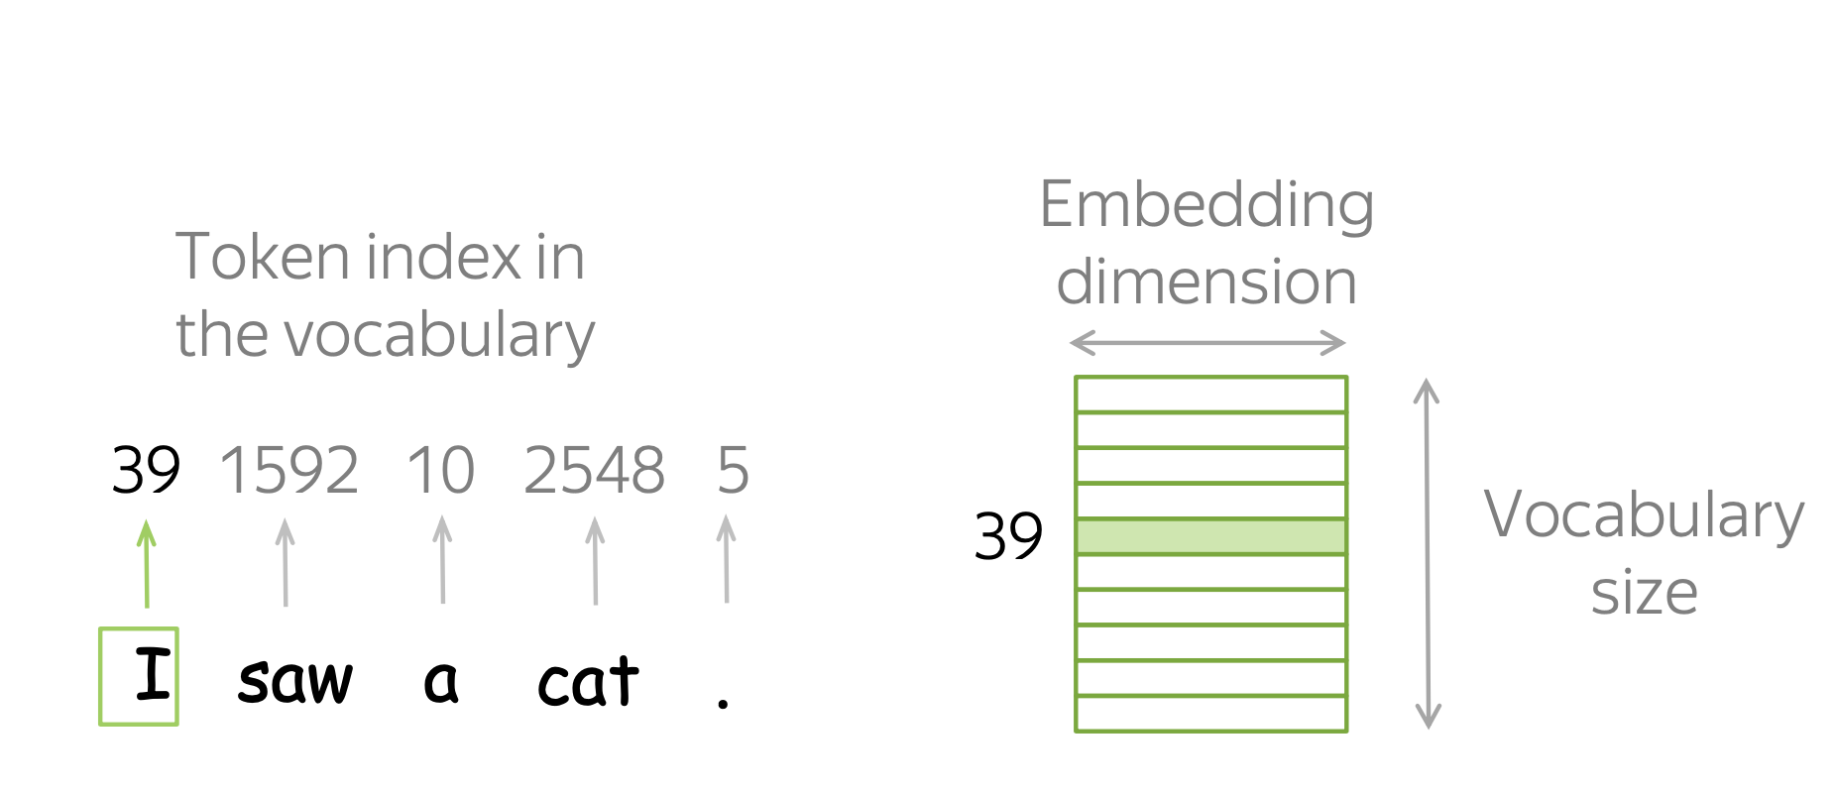
How it works?
Just a look up table

Slide 8
So what we shall do?
Your favourite ML model
We shall understand how to get these vectors
I train a model .
I train a model.

Slide 9
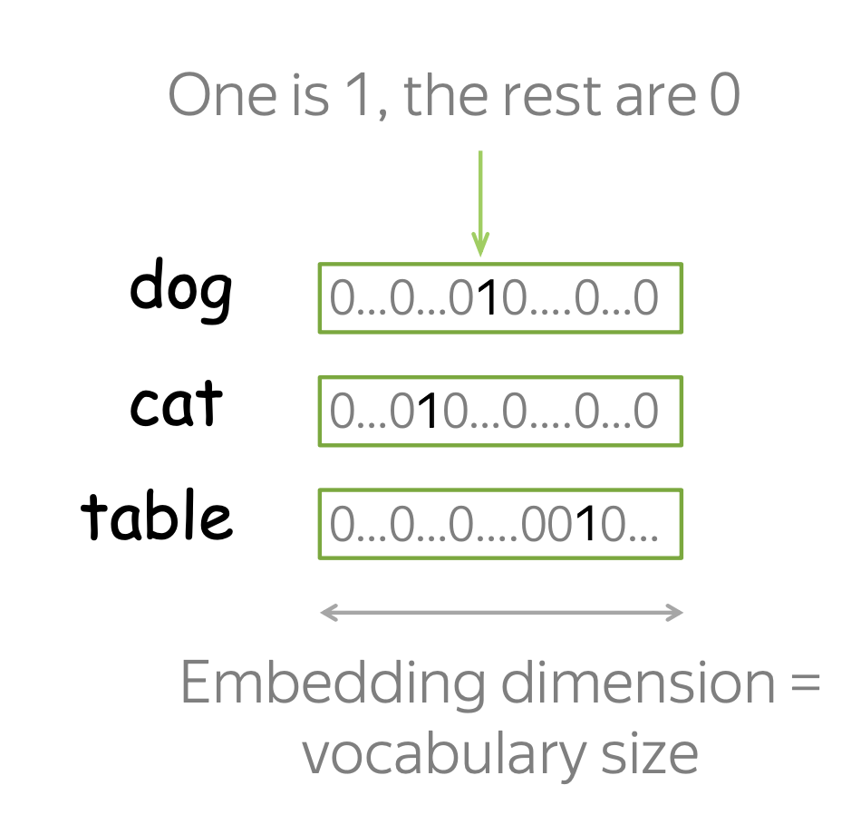
First approach. One-hot Vectors

Slide 10
First approach. One-hot Vectors
Are there any problems?

Slide 11
First approach. One-hot Vectors
Are there any problems?
Very long vectors
Vector of “dog” and vector of “cat” are orthogonal
to each other. All vectors are orthogonal
In other words, the vectors do not capture meaning

Slide 12
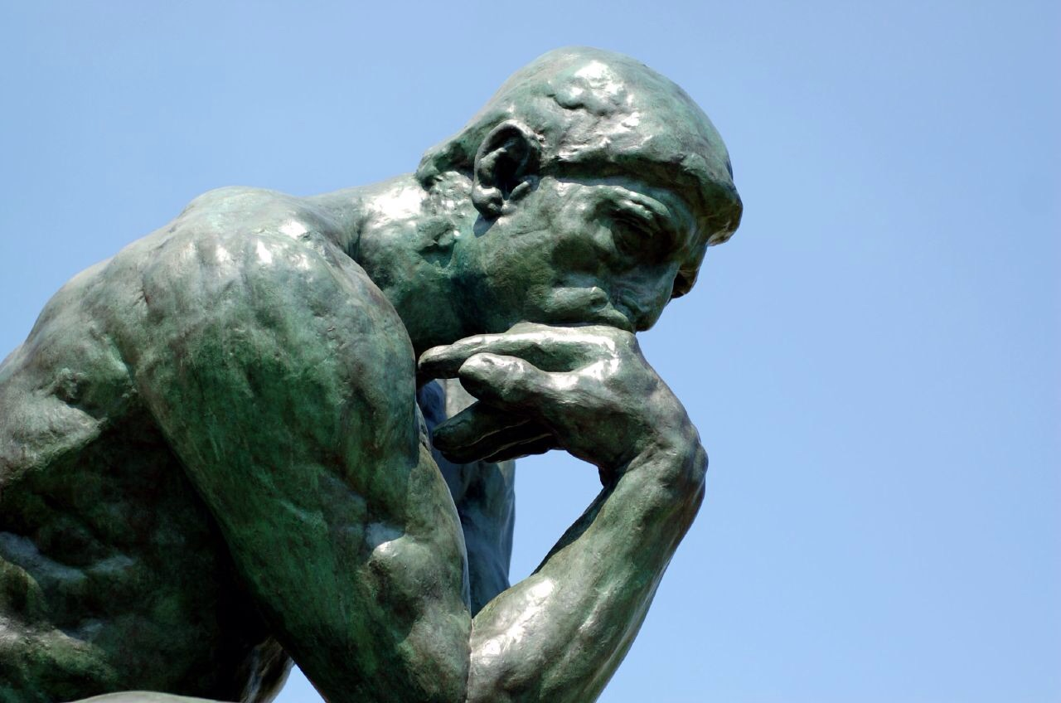
What is meaning?

Slide 13
What is meaning?
Do you know what the word Tesgüino means?

Slide 14
What is meaning?
Do you know what the word Tesgüino means?
Let’s look at it in different contexts:
A bottle of Tesgüino is on the table.
Everyone likes Tesgüino.
Tesgüino makes you drunk.
We make Tesgüino out of corn.

Slide 15
What is meaning?
Do you know what the word Tesgüino means?
Let’s look at it in different contexts:
A bottle of Tesgüino is on the table.
Everyone likes Tesgüino.
Tesgüino makes you drunk.
We make Tesgüino out of corn.
What Tesgüino means?

Slide 16
What is meaning?
Do you know what the word Tesgüino means?
Let’s look at it in different contexts:
A bottle of Tesgüino is on the table.
Everyone likes Tesgüino.
Tesgüino makes you drunk.
We make Tesgüino out of corn.
What Tesgüino means?
Tesgüino is an alcoholic beverage made from corn

Slide 17
What is meaning?
How did you do this?
With context you can understand meaning

Slide 18
What is meaning?
Let’s look at other possible words:
A bottle of Tesgüino is on the table. Wine? Milk?
Everyone likes Tesgüino. Cats? Wine?
Tesgüino makes you drunk. Wine? Vodka?
We make Tesgüino out of corn. Meal? Casserole?

Slide 19
What is meaning?
Let’s look at other possible words:
A bottle of Tesgüino is on the table. Wine? Milk?
Everyone likes Tesgüino. Cats? Wine?
Tesgüino makes you drunk. Wine? Vodka?
We make Tesgüino out of corn. Meal? Casserole?
Contexts are similar
Meaning is similar

Slide 20
What is meaning?
Let’s look at other possible words:
A bottle of Tesgüino is on the table. Wine? Milk?
Everyone likes Tesgüino. Cats? Wine?
Tesgüino makes you drunk. Wine? Vodka?
We make Tesgüino out of corn. Meal? Casserole?
Contexts are similar
Distributional Hypothesis
Meaning is similar

Slide 21
Distributional hypothesis
Words that frequently appear in similar context have similar meaning
Or
You shall know a word by the company it keeps © J. R. Firth, 1957
This idea is very simple, yet very powerful and drives a lot of methods in NLP

Slide 22
1 minute history of AI/NLP
Amount of interest for AI:
time
Research papers:
1969,
Computational geometry,
Minsky
1986,
Backpropagation,
Hinton
1997,
LSTM,
Schmidhuber
2013,
Word2Vec,
Mikolov
1957,
Perceptron,
Rozenblatt,
1965,
ELIZA,
Weizenbaum
1976,
Speech recognition,
Reddy
1988,
AI Winter 2,
Minsky
2007,
Boltzman Machines,
Hinton
2018,
BERT,
Devlin
time

Slide 23
Classical Approach + Distributional Hypothesis = PMI
The main idea: We have to put information about contexts into word vectors
How?
Just put it manually based on global corpus statistics

Slide 24
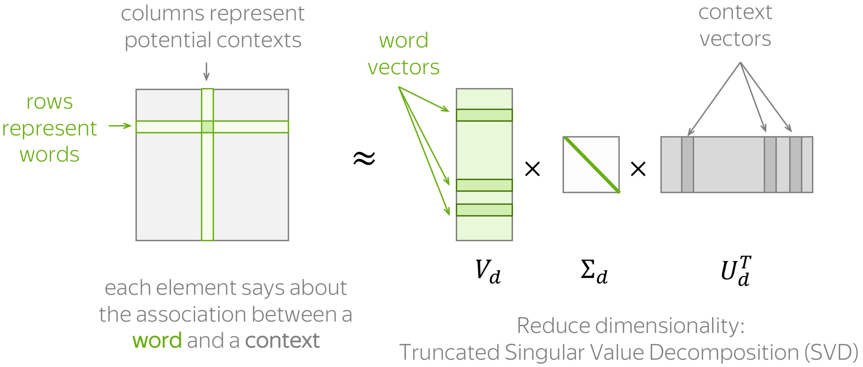
Classical Approach + Distributional Hypothesis = PMI
General pipeline

Slide 25
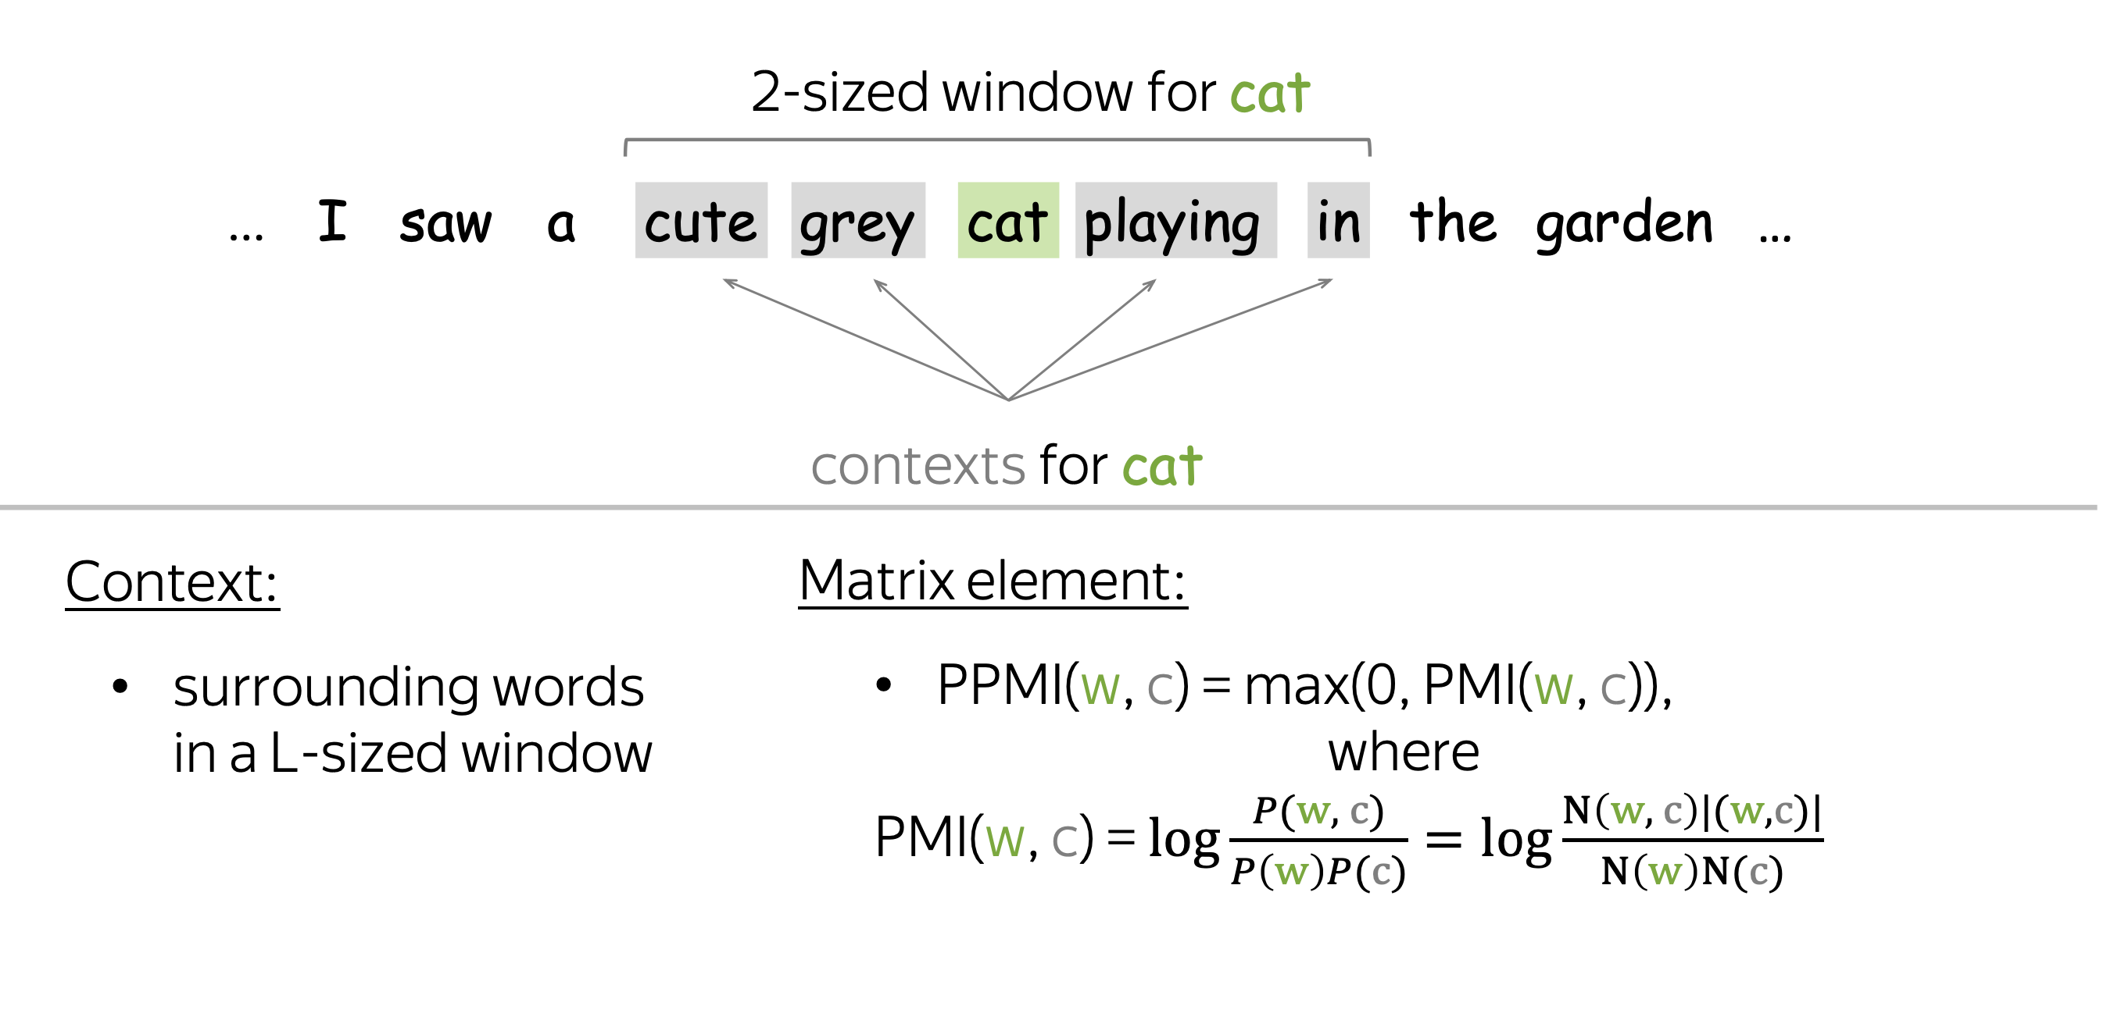
Classical Approach + Distributional Hypothesis = PMI
Example

Slide 26
Neural Approach + Distributional Hypothesis = Word2Vec
The main idea: learn word vectors by teaching the to predict contexts
When we predict context, we predict meaning
Learned parameters: word vectors
Goal: make each vector know about the contexts of its world
How: train vectors to predict possible contexts from words

Slide 27

Word2Vec
Take a huge corpus

Slide 28
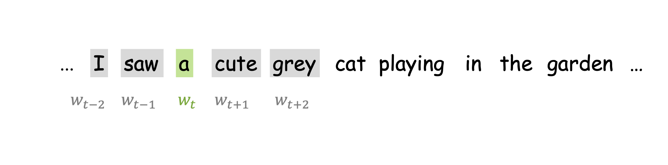
Word2Vec
Take a huge corpus
Go over a text with a window of fixed size moving one word at a time

Slide 29
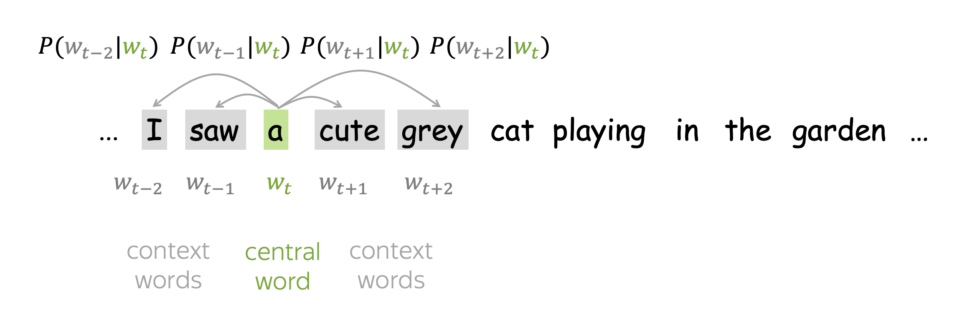
Word2Vec
Take a huge corpus

Slide 30
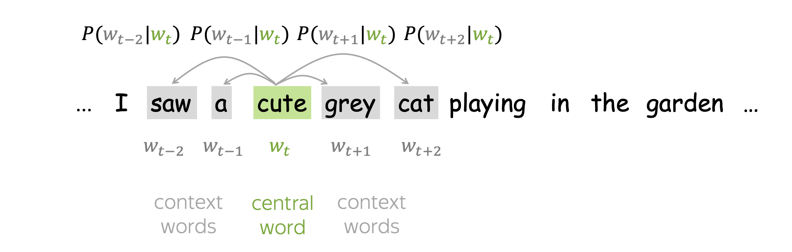
Word2Vec
Take a huge corpus

Slide 31
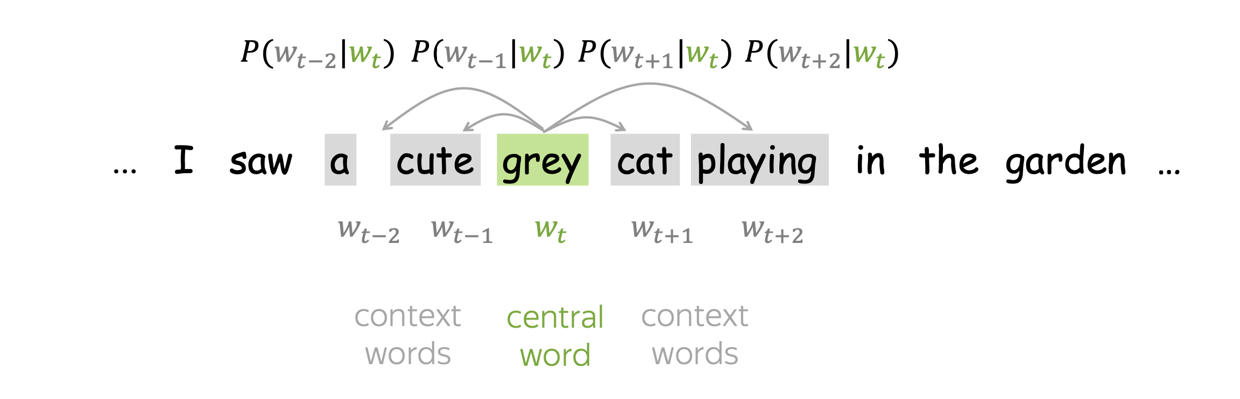
Word2Vec
Take a huge corpus

Slide 32
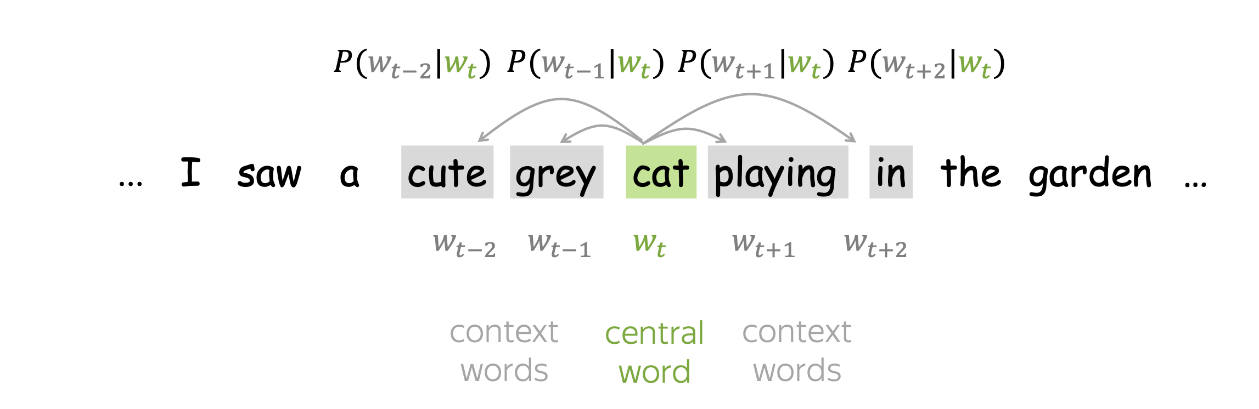
Word2Vec
Take a huge corpus

Slide 33
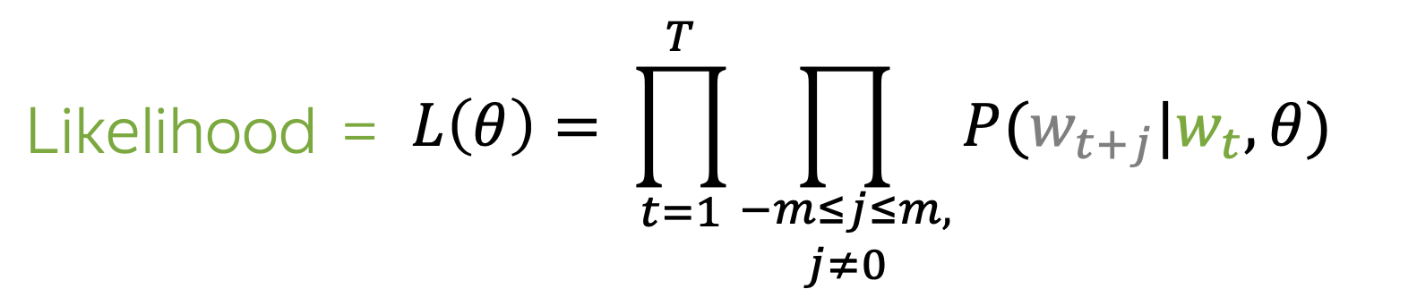
Word2Vec. How to train?
Word2Vec tries to adjust parameters in such a way that it maximizes the Likelihood:

Slide 34
Word2Vec. How to train?
Word2Vec tries to adjust parameters in such a way that it maximizes the Likelihood:
It is very problematic to optimize the product, because of the product rule
(uv)’ = u’v+uv’
(abc)’ = (ab)’c+(ab)c’ = a’bc+ab’c+abc’
How can we simplify it?

Slide 35
Word2Vec. How to train?
Word2Vec tries to adjust parameters in such a way that it maximizes the Likelihood:
Let’s use logarithm as a transformation function.
Why?
Logarithm is monotonic – does not change extrema
Logarithm transforms products into summations

Slide 36
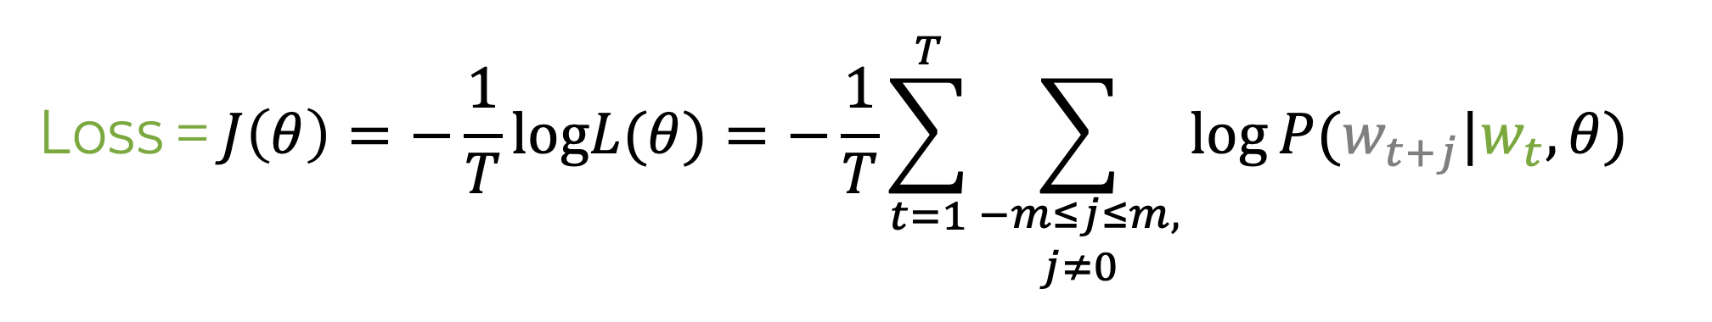
Word2Vec. How to train?
Word2Vec tries to adjust parameters in such a way that it maximizes the Likelihood:
In order to do it we can try to minimize the negative log-likelihood:

Slide 37
Word2Vec. How to train?
Word2Vec tries to adjust parameters in such a way that it maximizes the Likelihood:
In order to do it we can try to minimize the negative log-likelihood:
How can we compute this

Slide 38
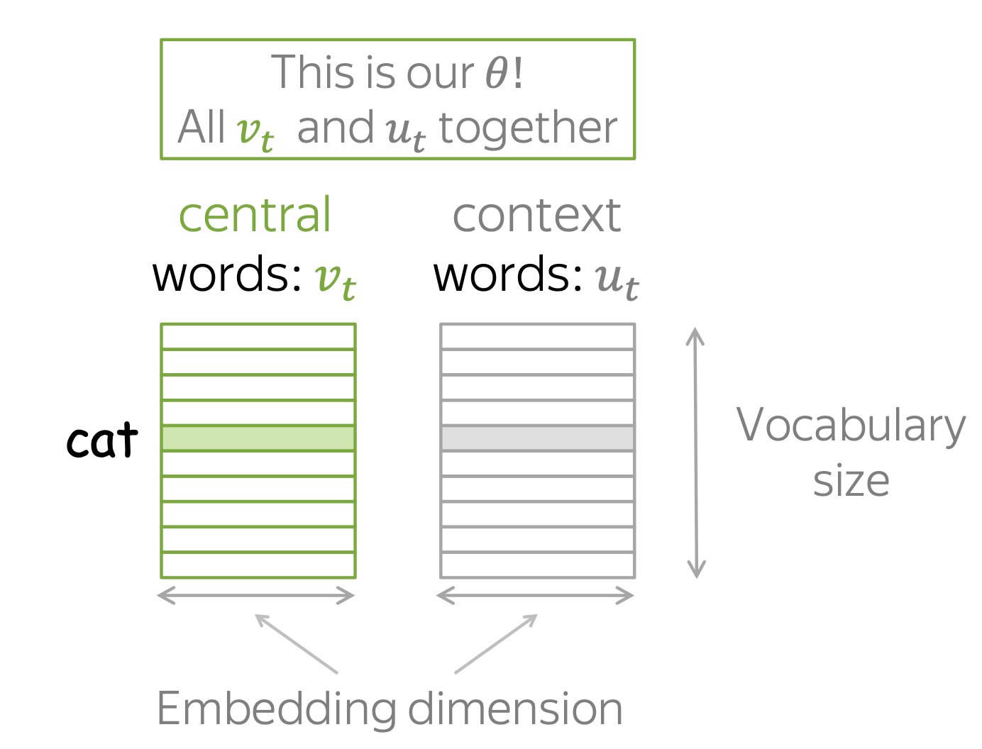
Word2Vec. Computation of probabilities
For each word, we will set two vectors:
Vector of “central” word
Vector of “context” word

Slide 39
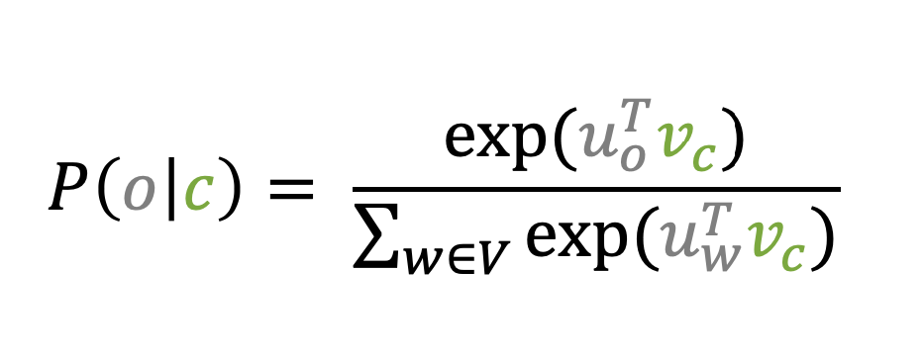
Word2Vec. Computation of probabilities
For central word c and context word o:

Slide 40
Word2Vec. Computation of probabilities
For central word c and context word o:
Dot product. Vectors more similar -> larger probability
Normalize over entire corpus to get probabilities

Slide 41
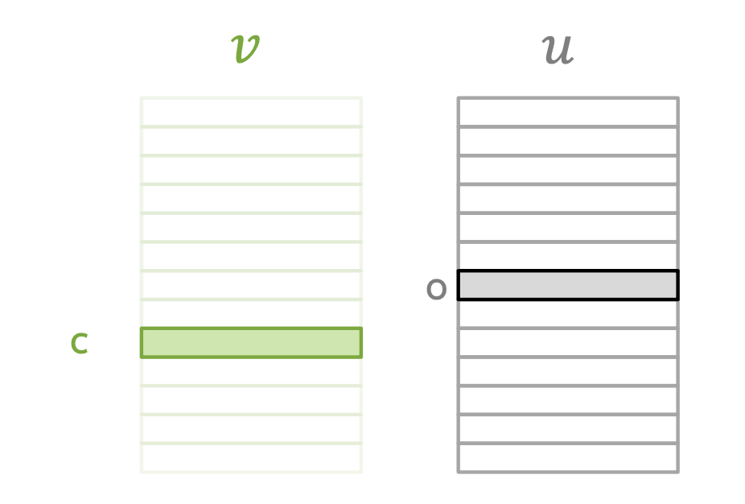
Word2Vec. Computation of probabilities
For central word c and context word o:
Dot product. Vectors more similar -> larger probability
Normalize over entire corpus to get probabilities
We adjust vectors to increase probabilities

Slide 42
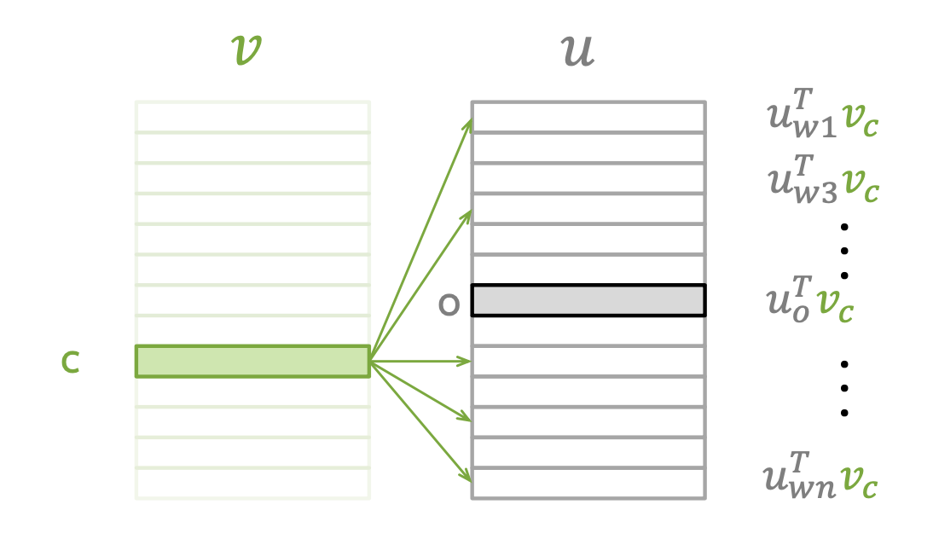
Word2Vec. Computation of probabilities
For central word c and context word o:
Dot product. Vectors more similar -> larger probability
Normalize over entire corpus to get probabilities
We adjust vectors to increase probabilities

Slide 43
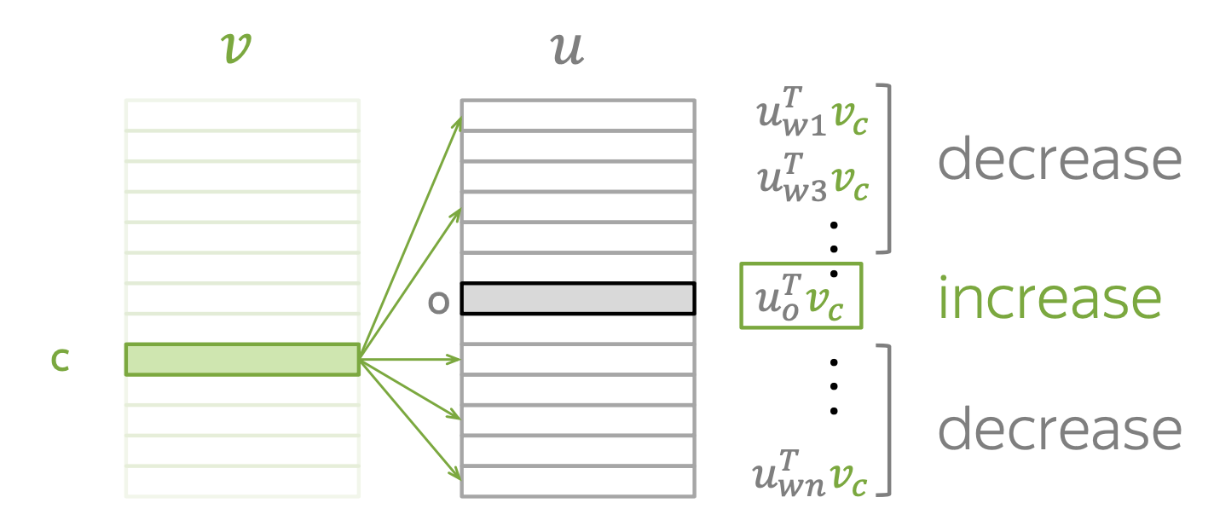
Word2Vec. Computation of probabilities
For central word c and context word o:
Dot product. Vectors more similar -> larger probability
Normalize over entire corpus to get probabilities
We adjust vectors to increase probabilities

Slide 44
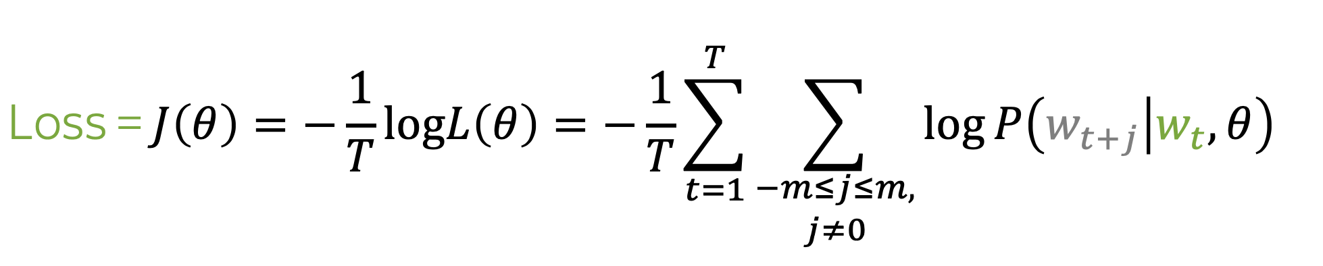
Word2Vec. One training step

Slide 45
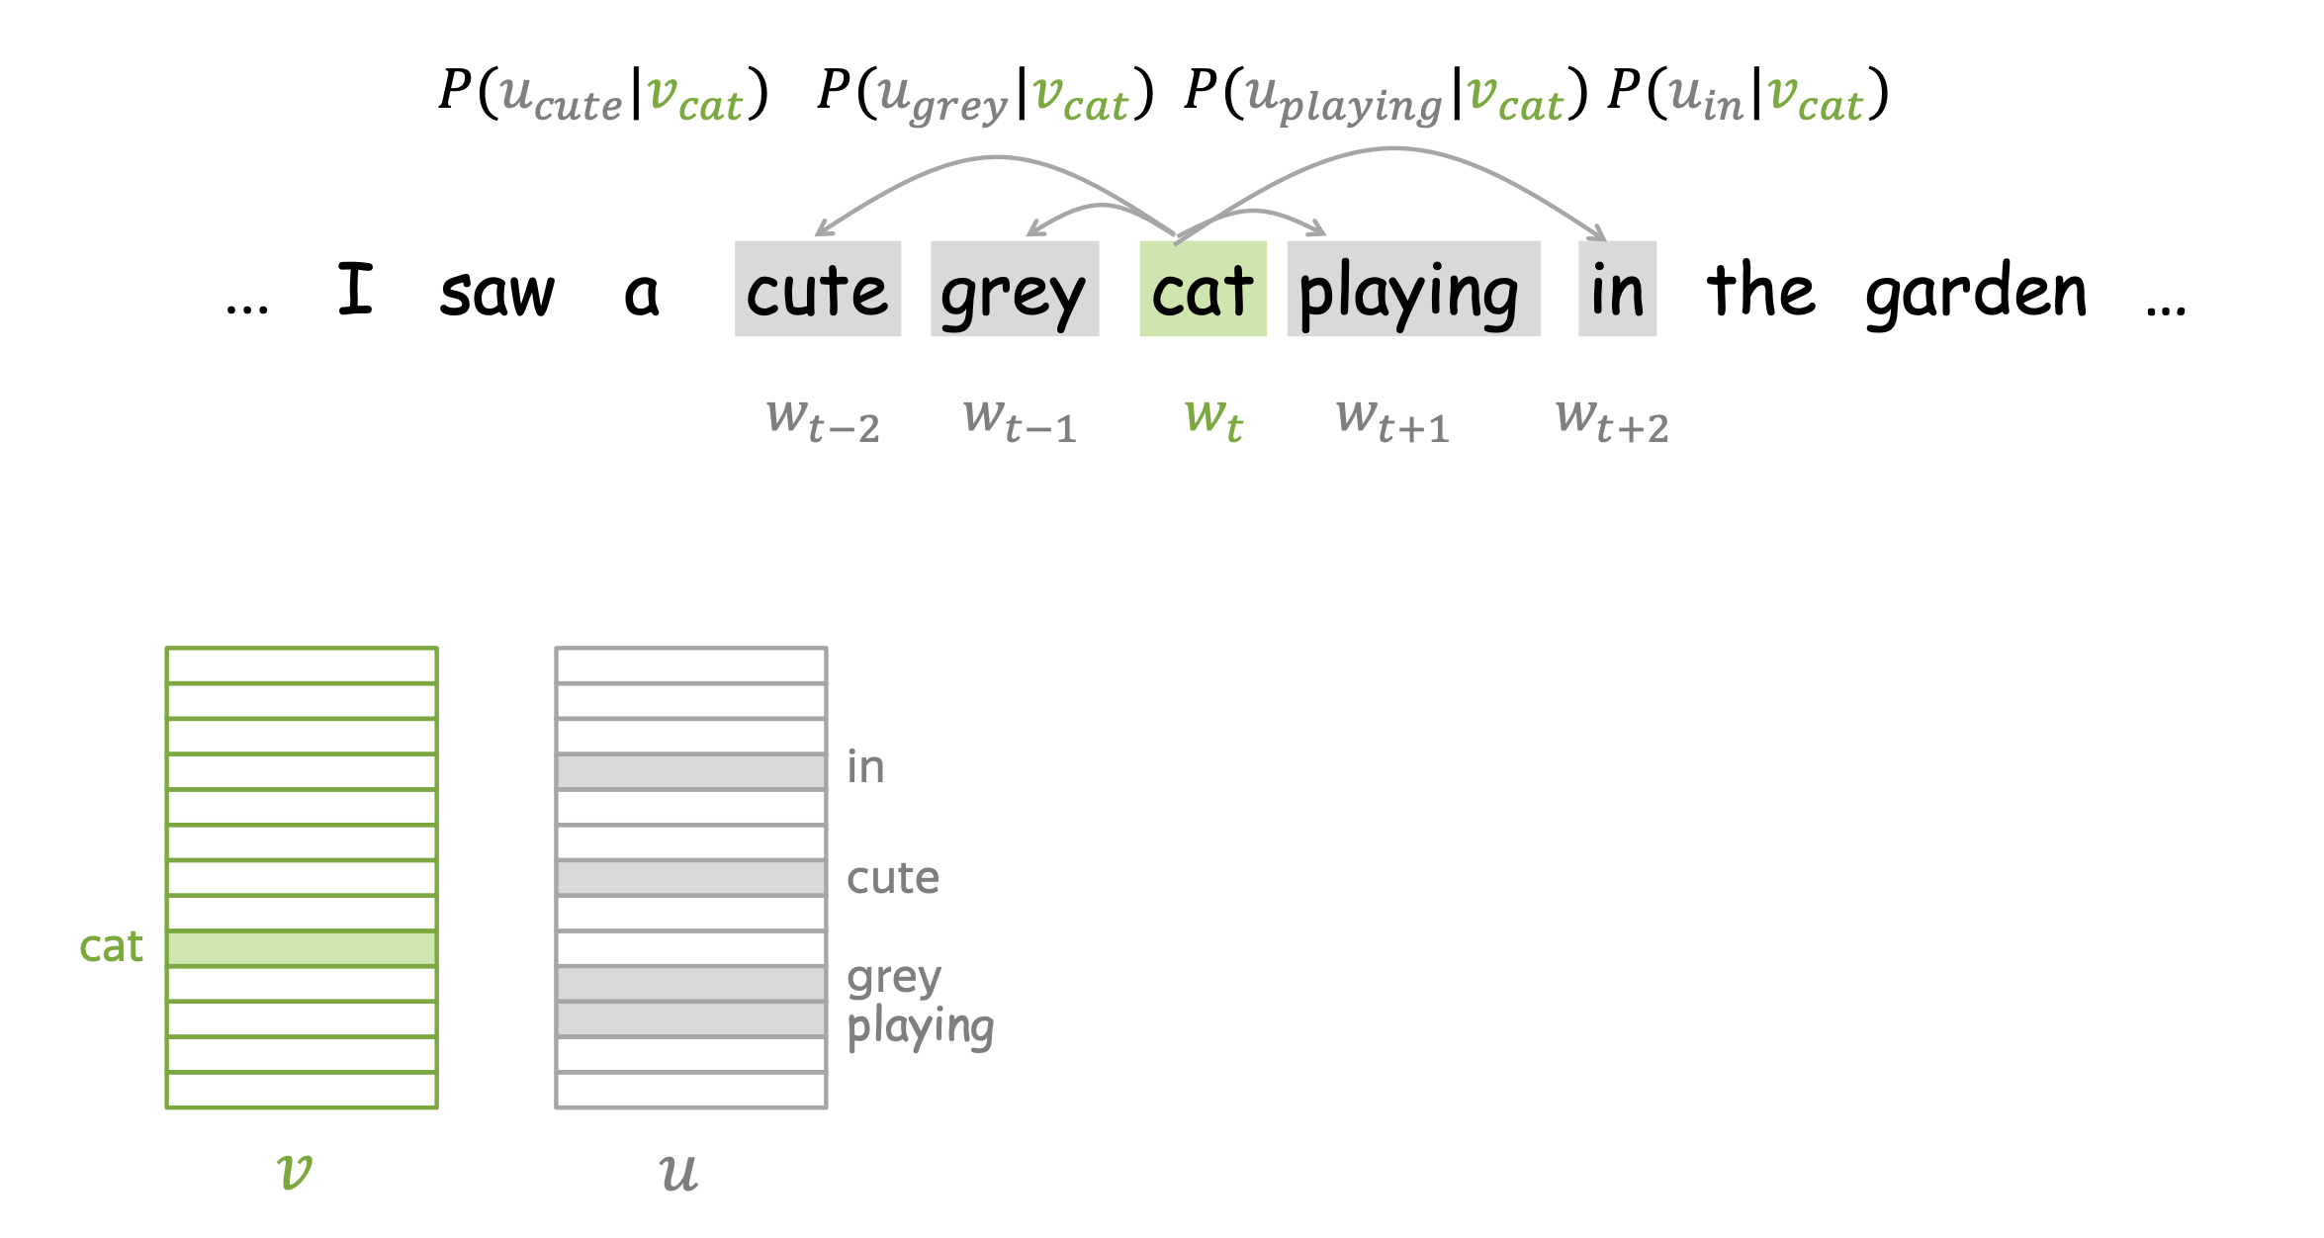
Word2Vec. One training step

Slide 46
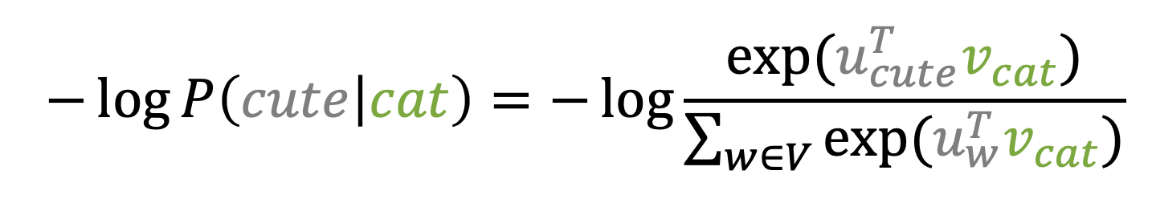
Word2Vec. One training step

Slide 47
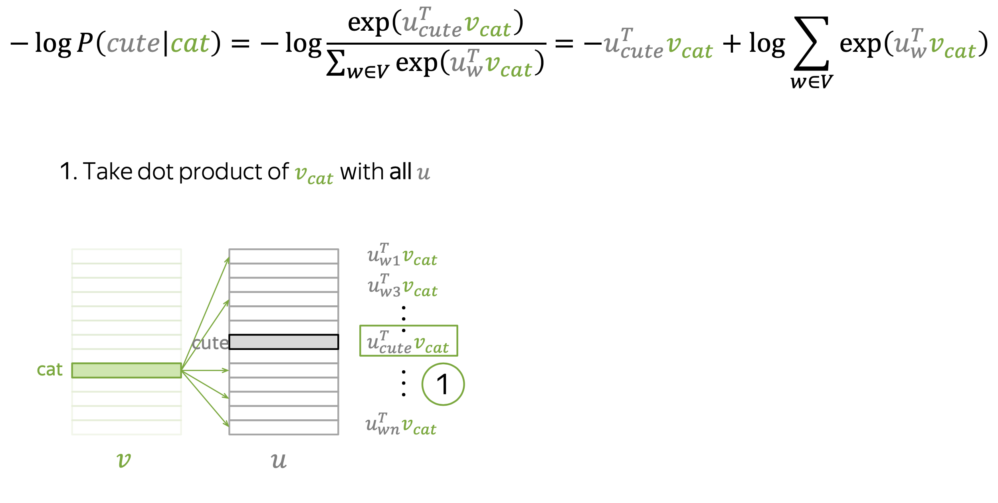
Word2Vec. One training step

Slide 48
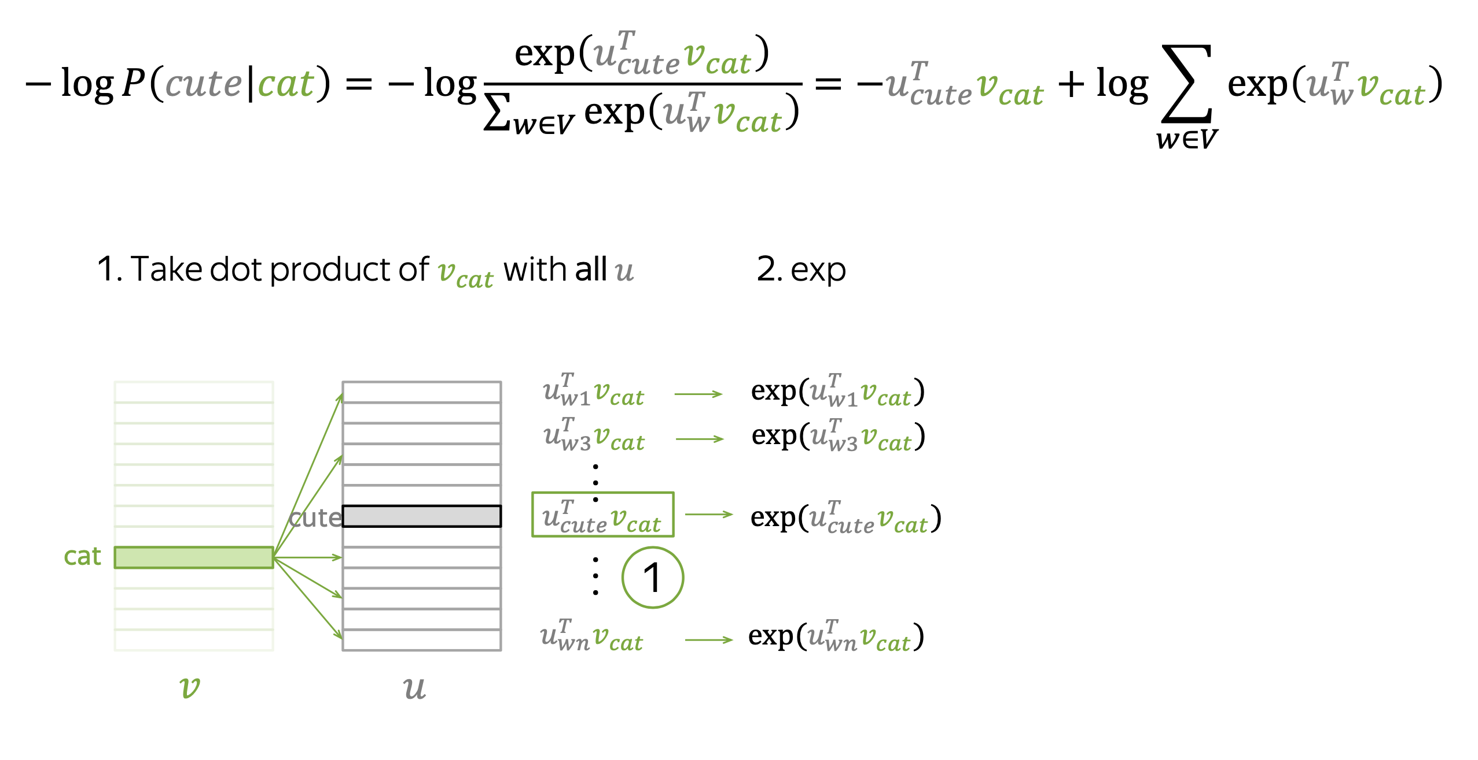
Word2Vec. One training step

Slide 49
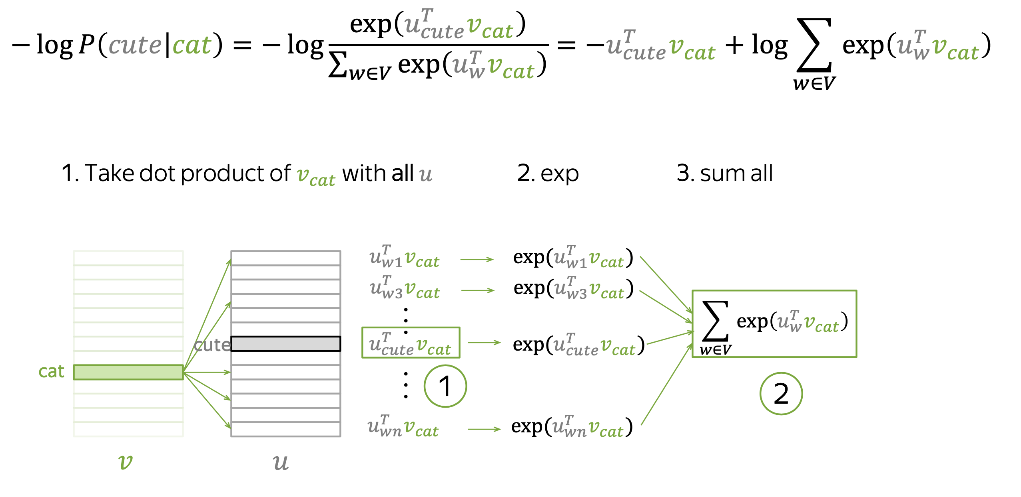
Word2Vec. One training step

Slide 50
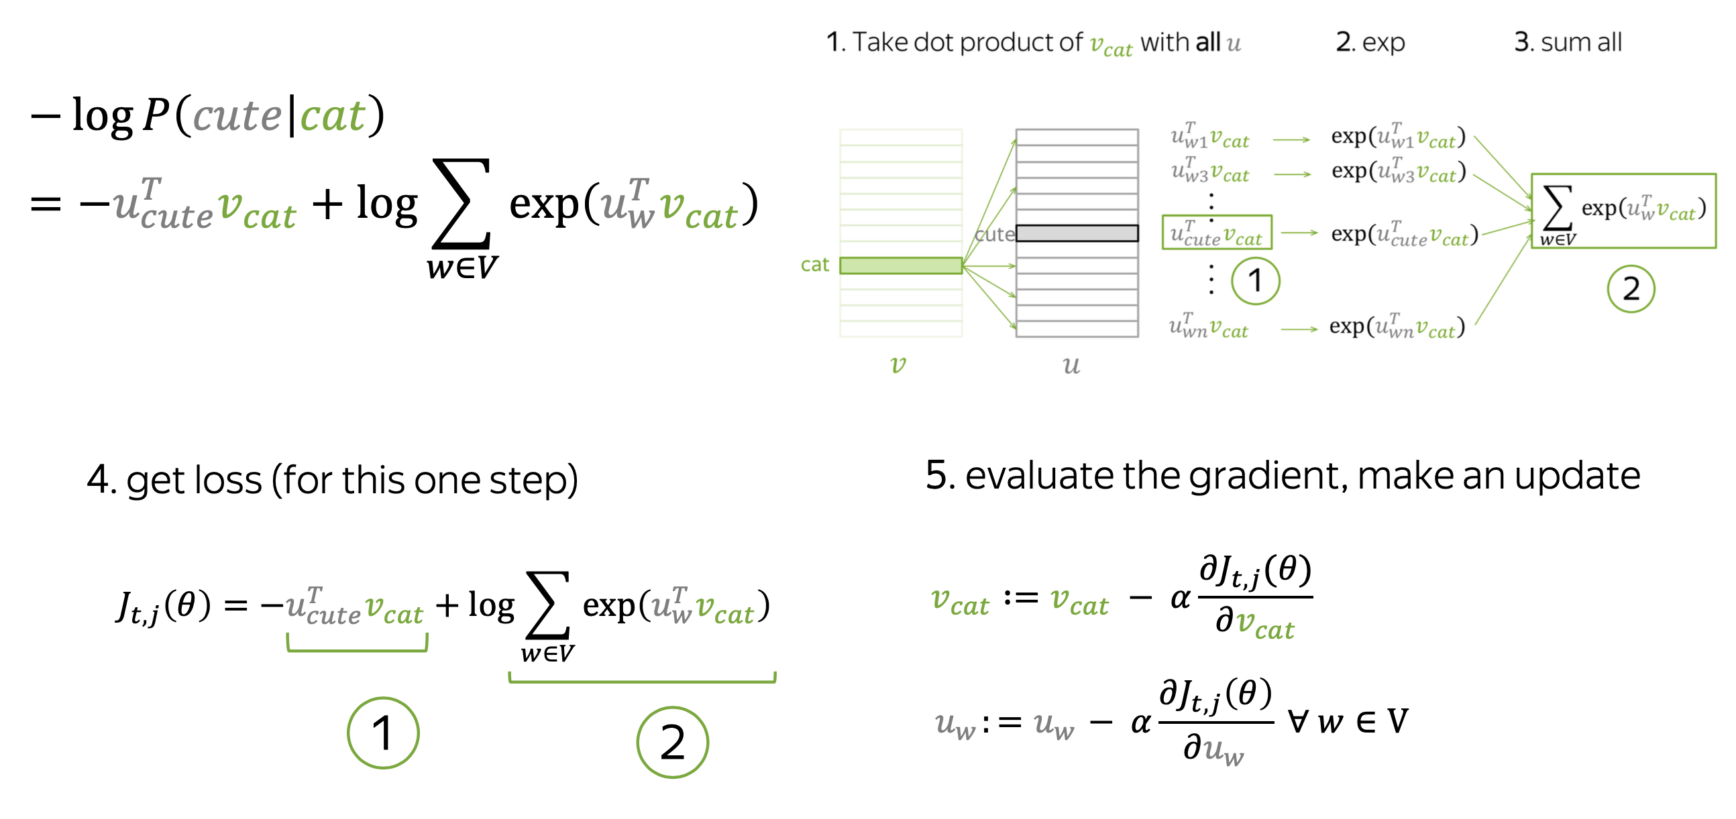
Word2Vec. One training step

Slide 51
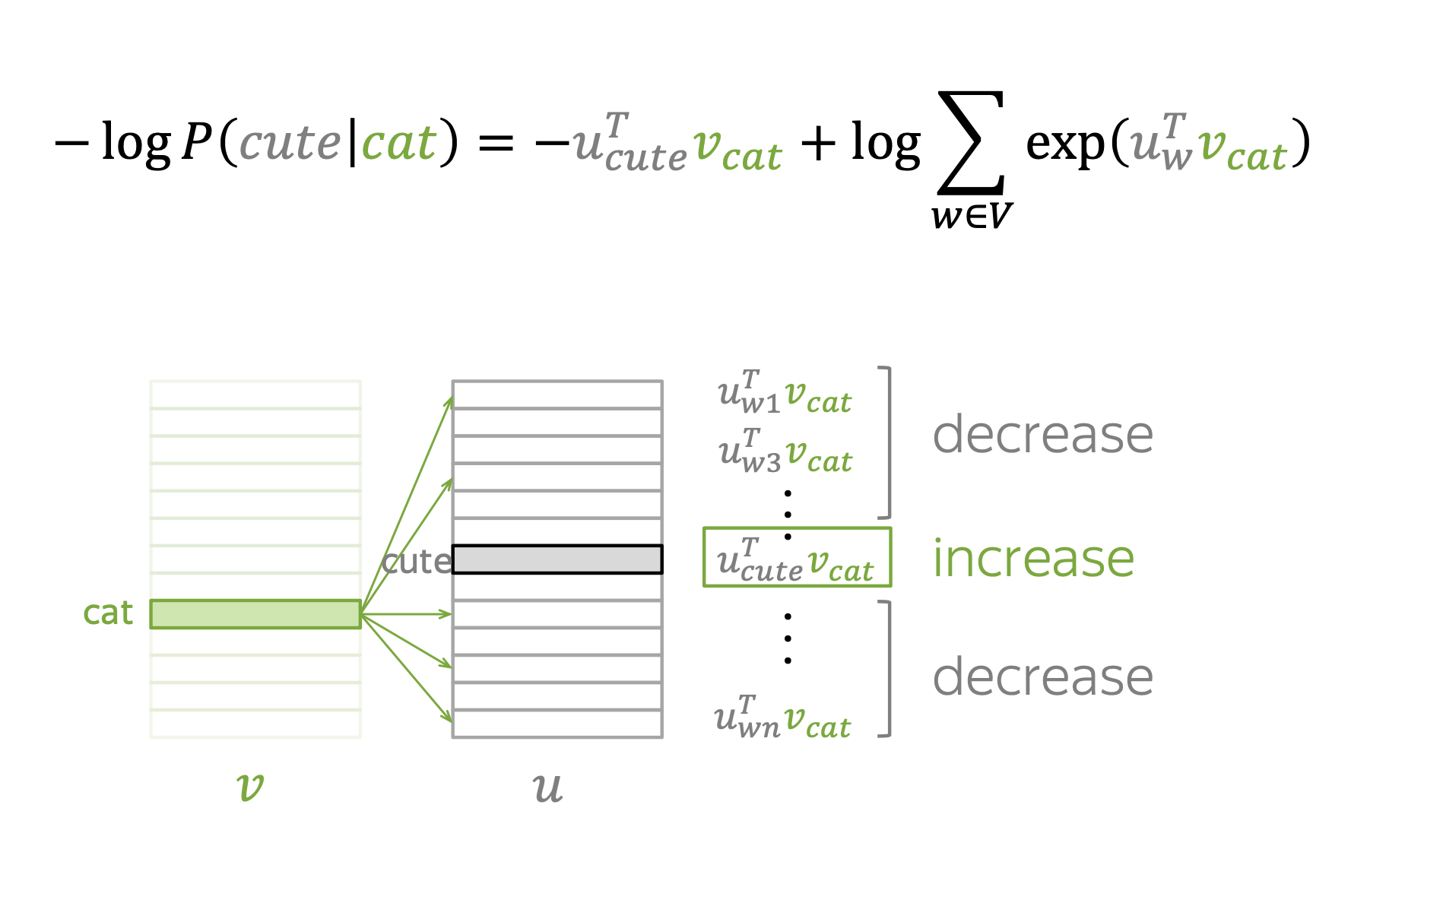
Word2Vec. One update intuition

Slide 52
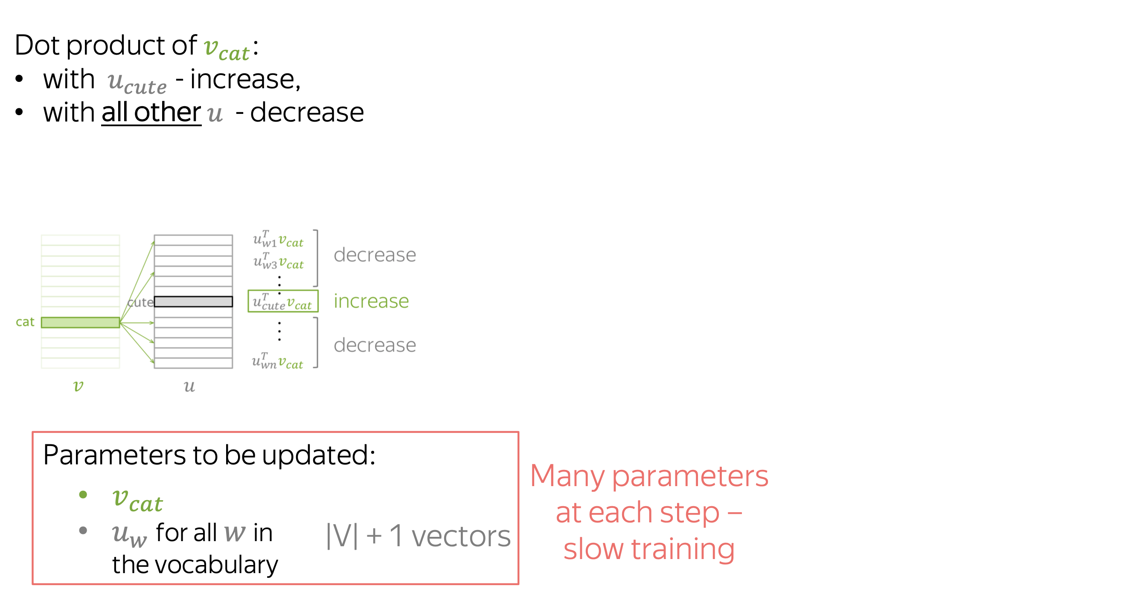
Word2Vec. How many parameters updated

Slide 53
Word2Vec. How many parameters updated
Can we do better?

Slide 54
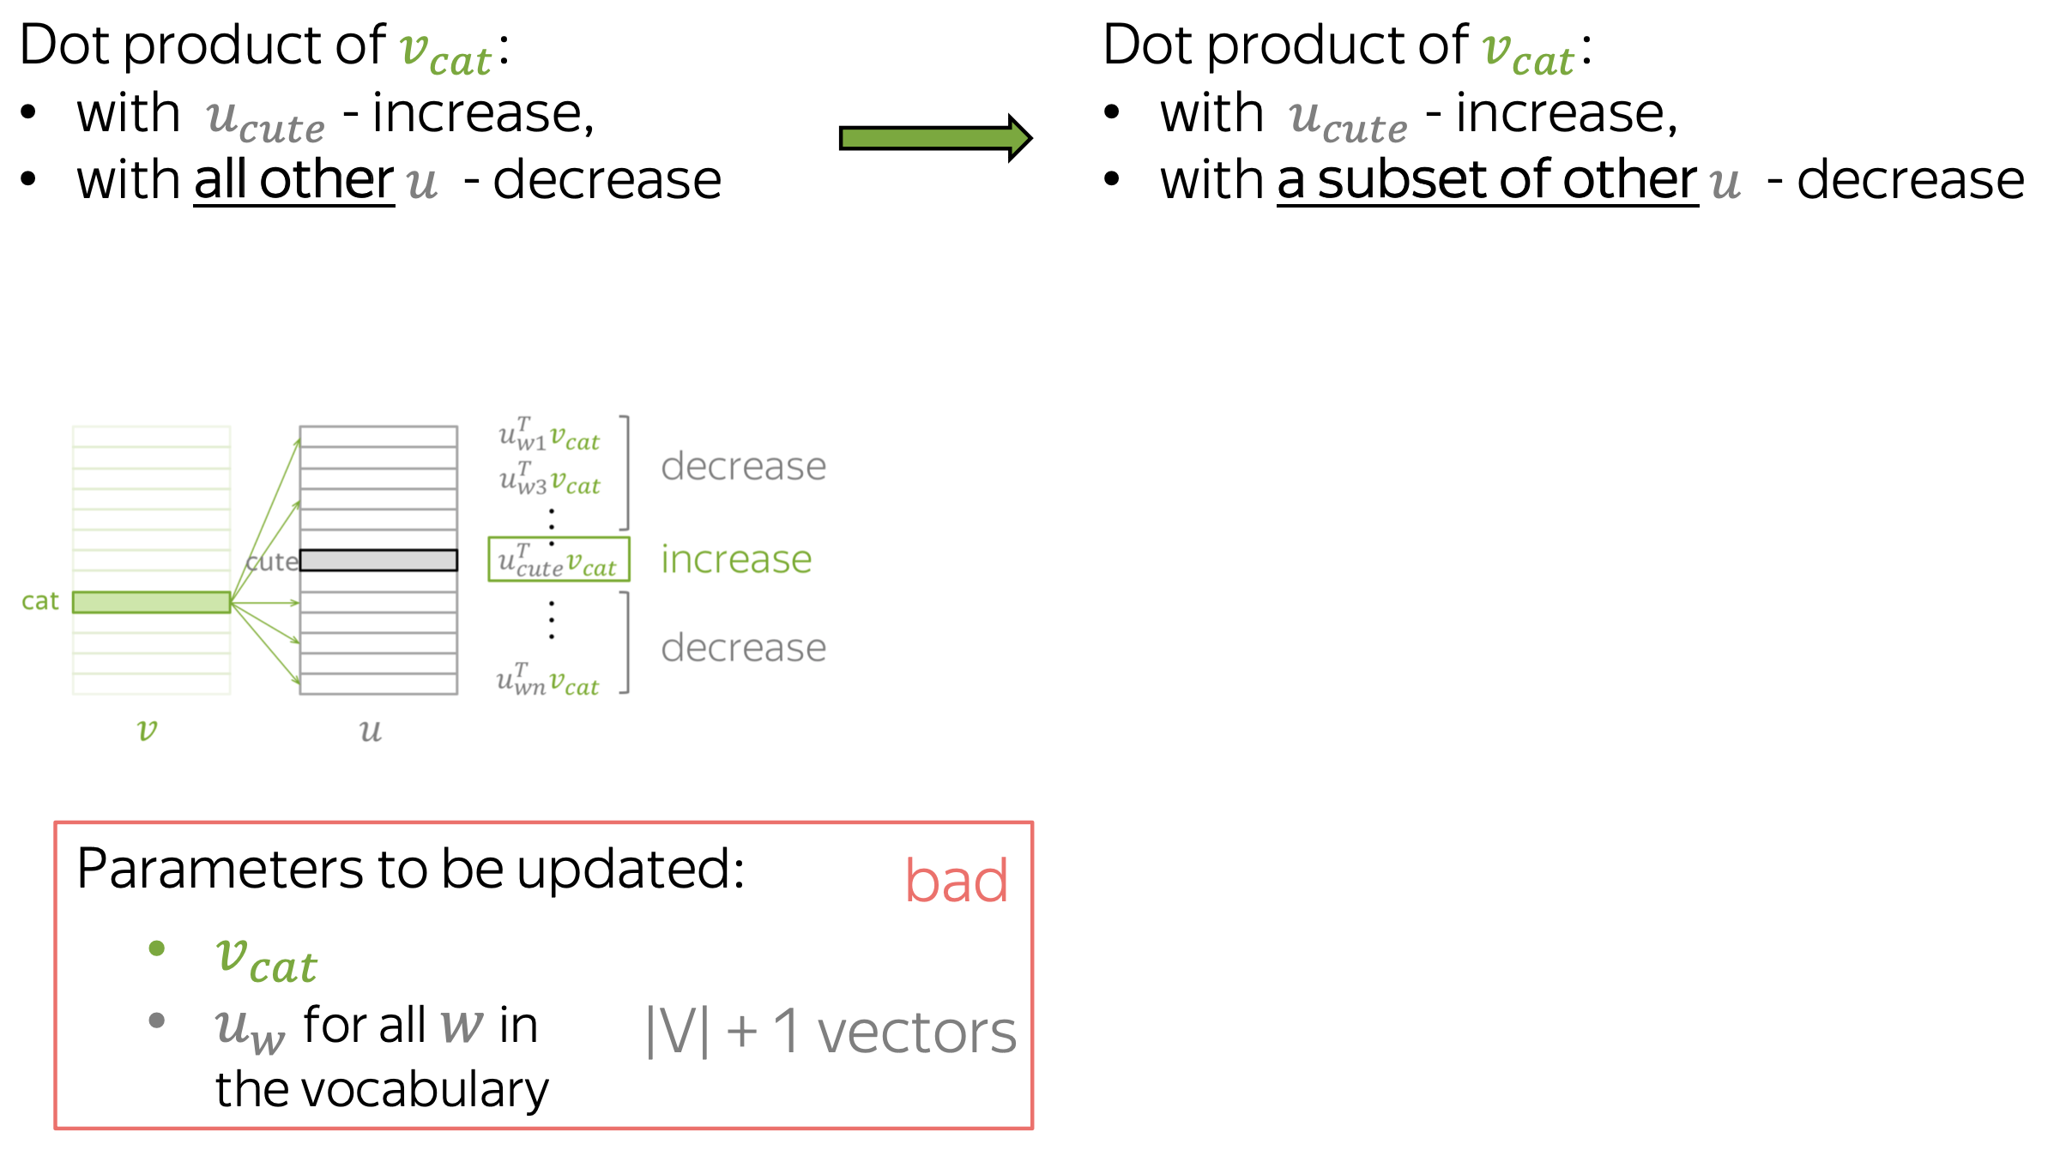
Word2Vec + Negative Sampling
Can we do better?

Slide 55
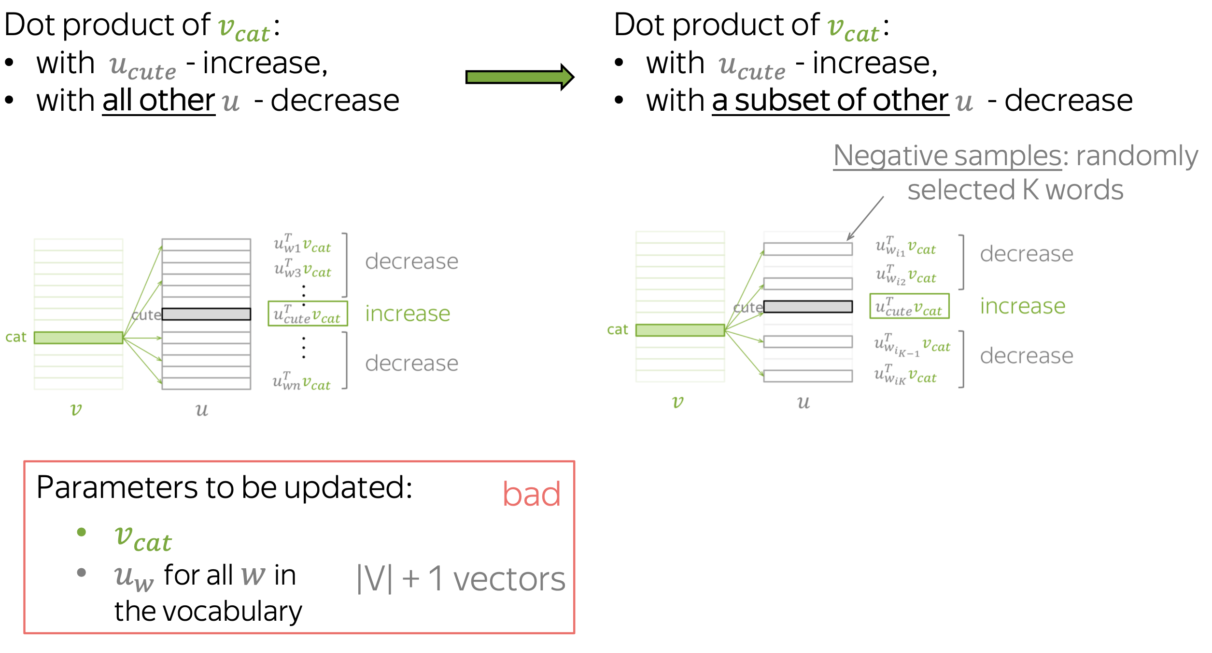
Word2Vec + Negative Sampling
Can we do better?

Slide 56
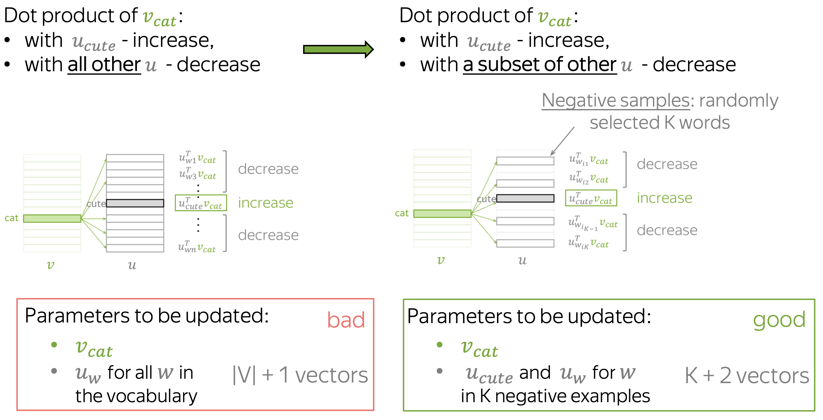
Word2Vec + Negative Sampling

Slide 57
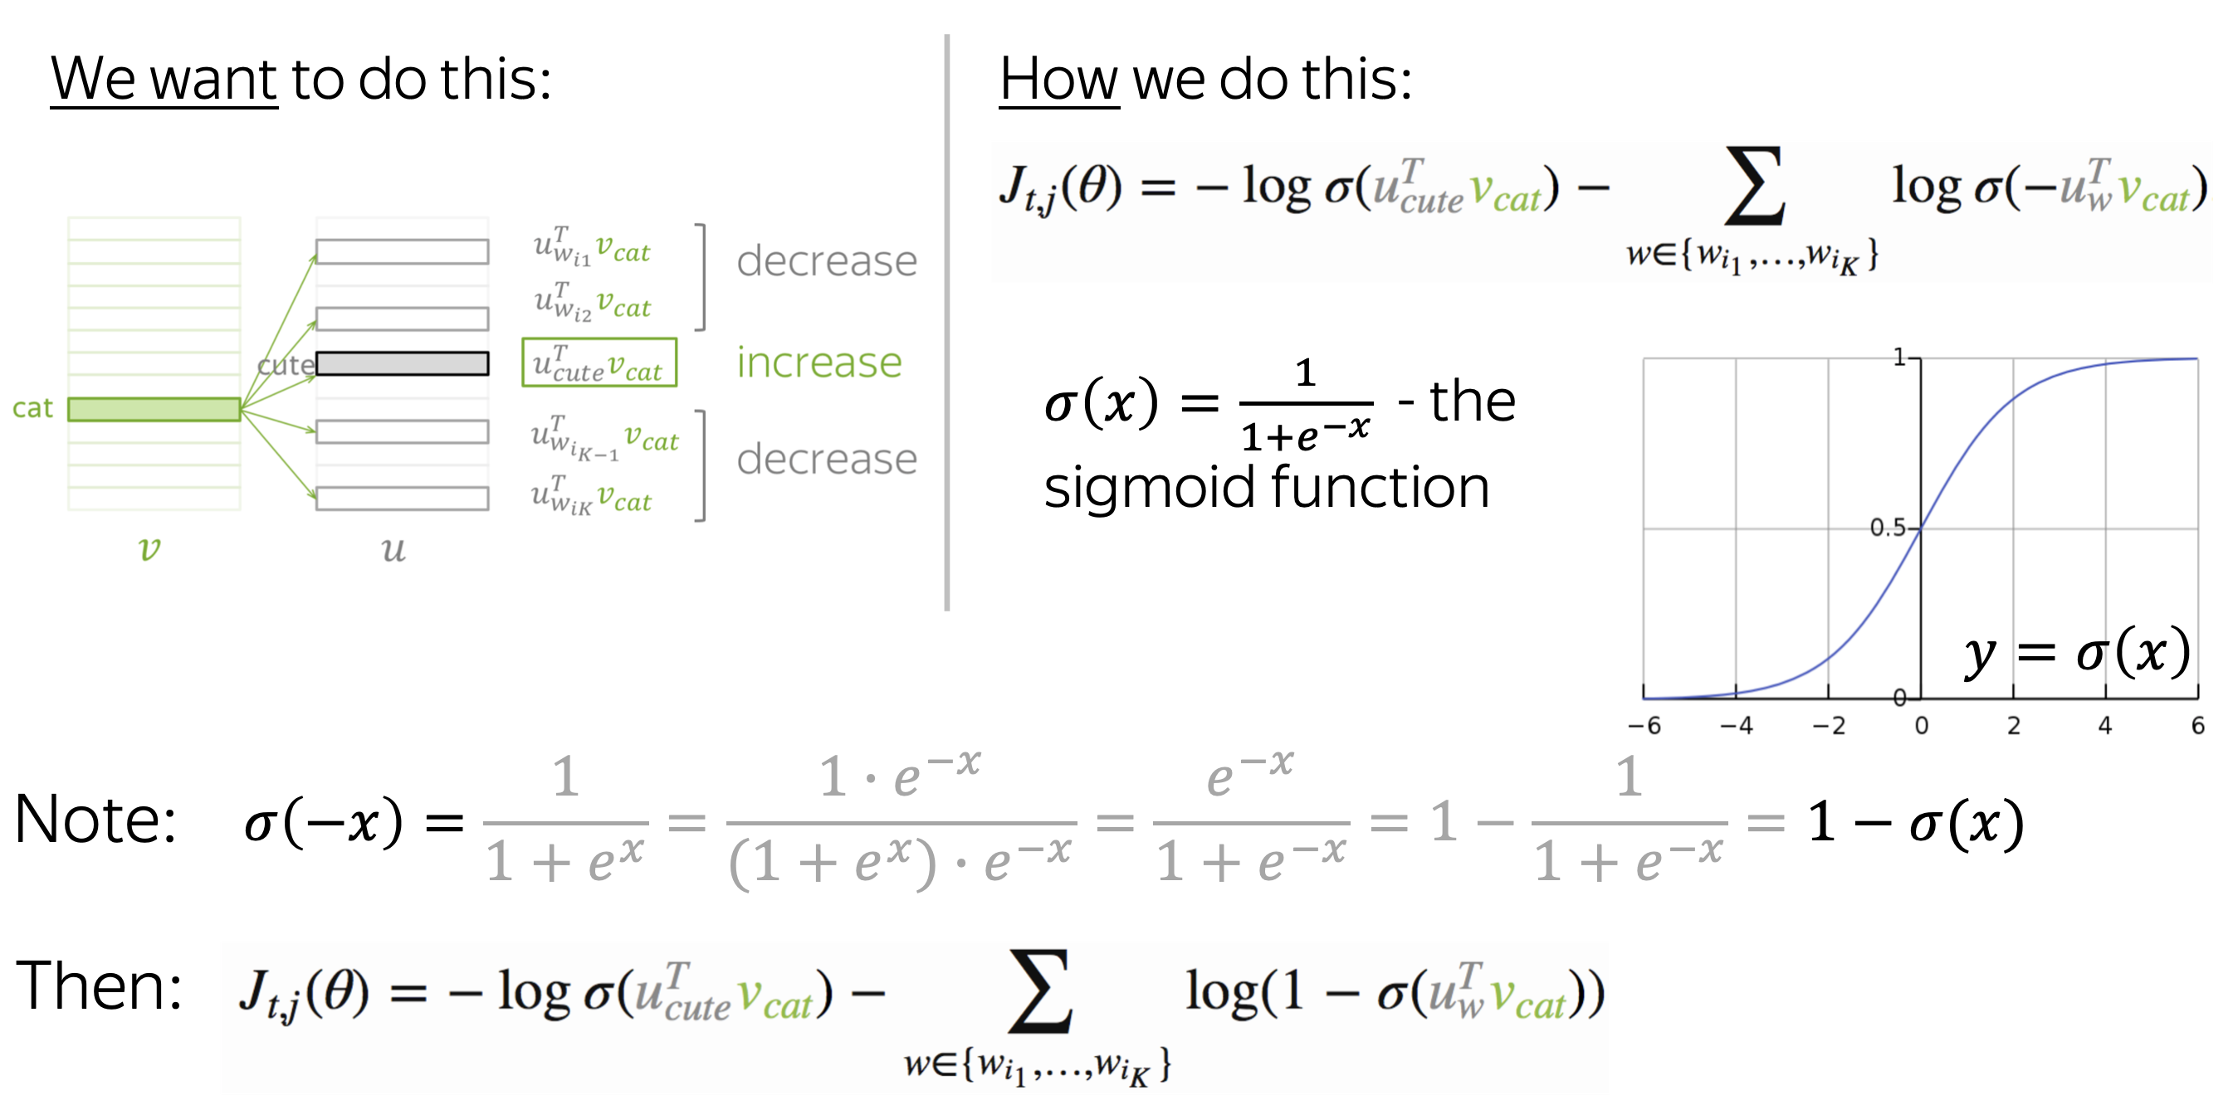
Word2Vec + Negative Sampling (Loss function)

Slide 58
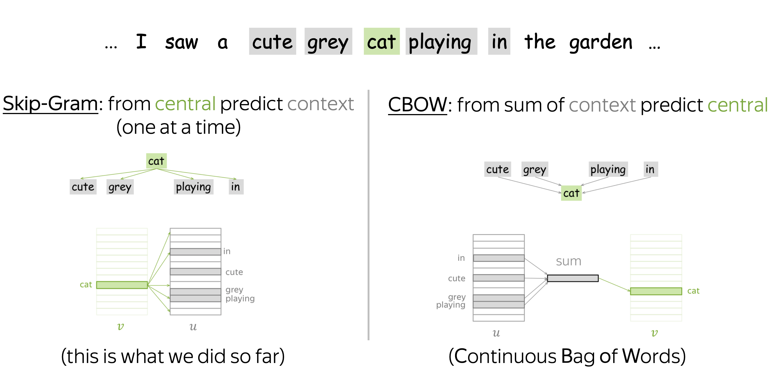
Word2Vec. 2 versions

Slide 59
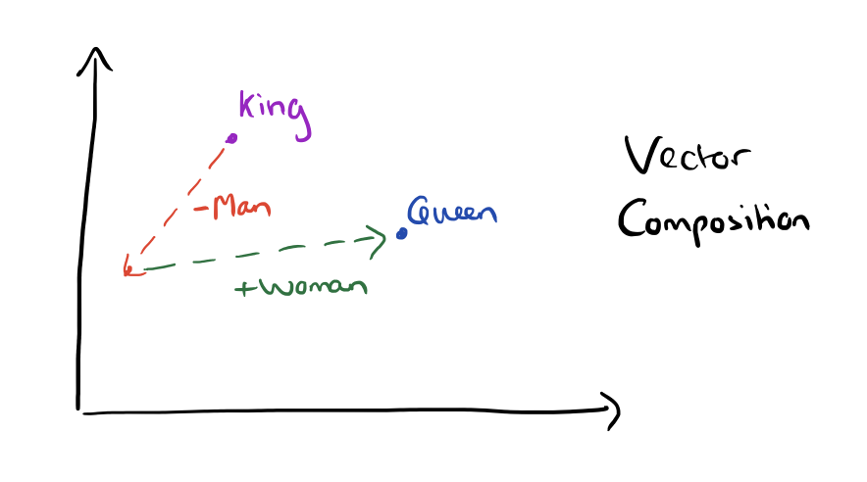
Word2Vec. What do we get from these representations?

Slide 60
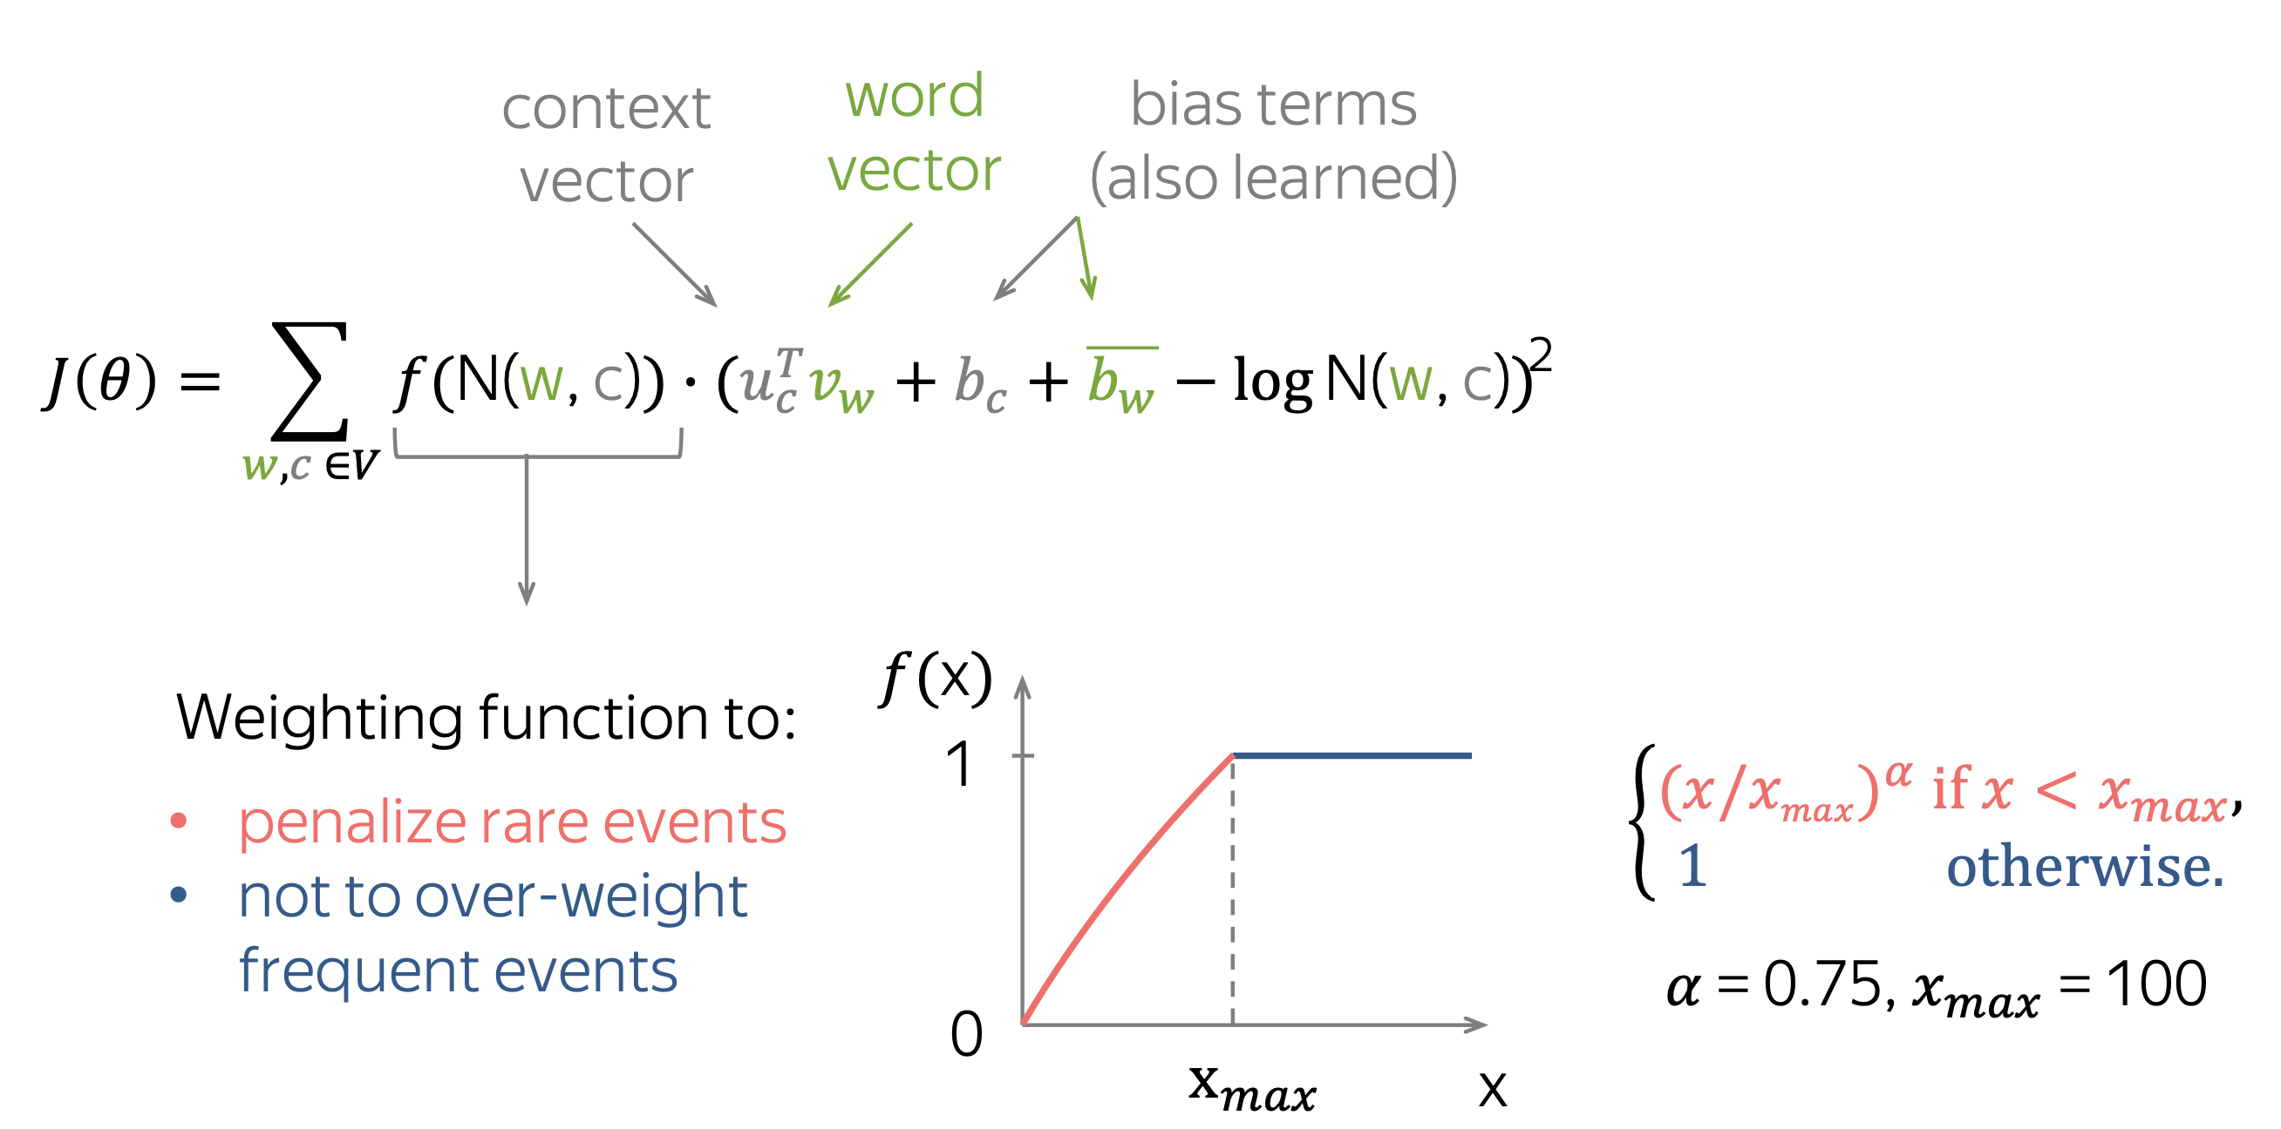
GloVE. Global vectors for Word Representations

Slide 61
Word2Vec. Naïve Implementation
Let’s implement word2vec from scratch.
https://colab.research.google.com/github/RepTrak/nlp-course/blob/develop/Week1/seminar_1.ipynb
The homework # 1 is to implement Negative Sampling version.

Slide 62
Credit to lecture materials
Moscow Institute of Physics and Technology:
https://github.com/mmta-team/mmta_fall_2020
Yandex School of Data Analysis:
https://github.com/yandexdataschool/nlp_course
Lena Voita (my teacher from YSDA) github:
https://lena-voita.github.io/nlp_course.html#preview_word_emb
Stanford CS224n lecture notes:
http://web.stanford.edu/class/cs224n/index.html#schedule

